Slide 1
Computer Graphics
Social Forces

Slide 2
Subtopics
Perception
The Parts
Implementation
Results

Slide 3
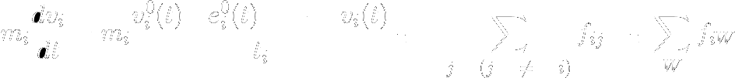
Social Forces – Definition
These are ones which combined, will affect the agent’s current direction vector. The following is the representation of the direction vector each agent will follow based on three basic forces applied on it.
normalized preferred force
entities repulsion force
entities proximity force
The main idea is to adjust the current steering based on the forces being applied on the agent.
The above equation results on a direction vector, given the following parameters:
t_{i} = time step
v⁰_{i}(t) = desired speed
e⁰_{i} = desired direction
v_{i}(t) = current velocity
m_{i} = mass of agent i
We will proceed to check the actual implementation or said formula

Slide 4

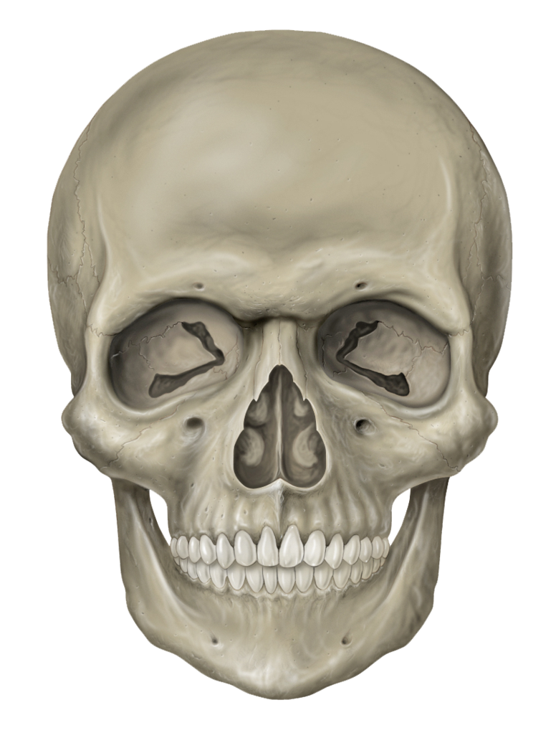
The Agent – Perception
Before exploring the implementation of social forces, it is necessary to understand the very foundations of what it makes it possible.
Let’s begin with agent perception of the observable world.
When it comes to model a character, it is convenient to break this into independent yet synergic modules.
A simple and intuitive approach would be:
Perception ← How is the world around the agent
AI / Deliberation ← What the agent should do next
Body Module ← How the agent acts
When it comes to forces, we will only focus on what is perceived, and how this affects the forces applied to the dynamic body.

Slide 5
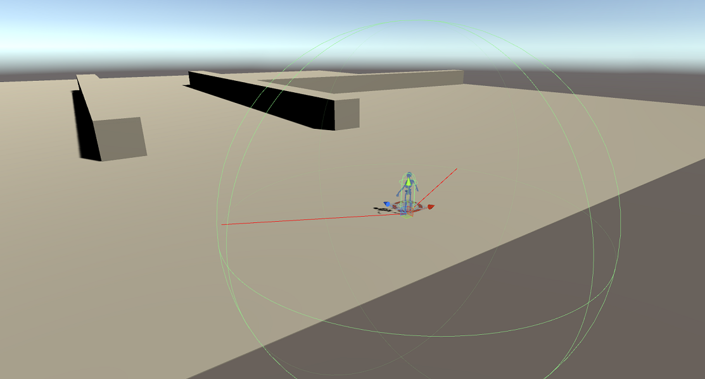
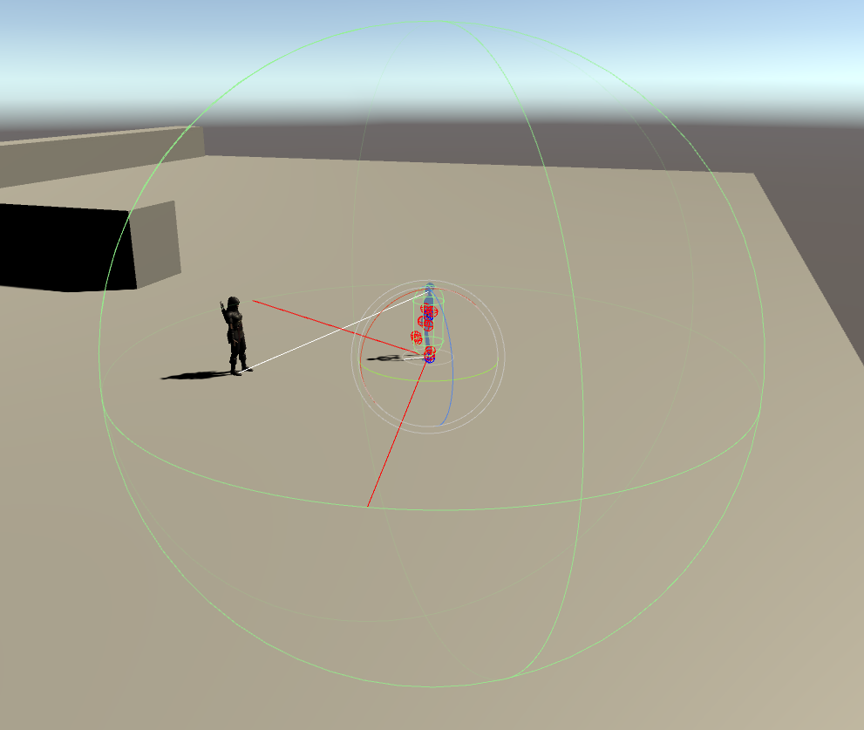
The Agent – Perception
Perception
Intuitively, it makes sense to think as perception as an spherical field, in which objects within it, might be able to be picked up by each agent. This implementation will give us the freedom of:
Limit the overall field of perception
Limit the field of view (this is our main concern for simple social forces)
Allows for categorizing type of perceived objects or entities and whether these are to be seen or heard.
Always bear in mind that for each frame, any computation to be processed regarding perception, will have a minimum cost in the order of O(n²)
← Manny’s perception sphere.
Erika has been spotted by Manny B. Jr. →

Slide 6
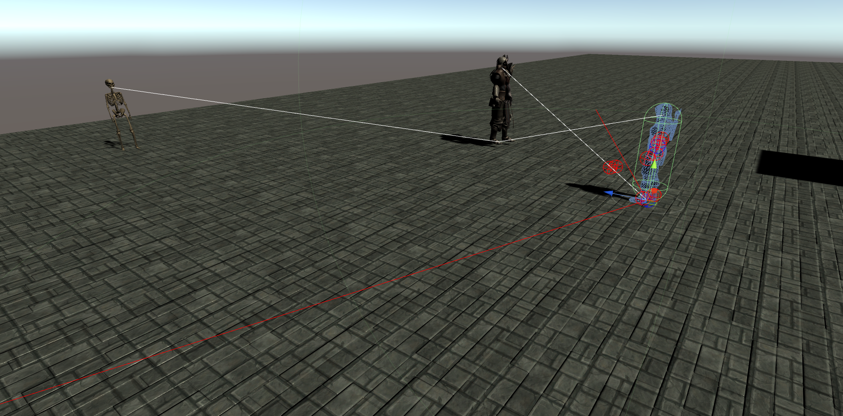
The Agent – Perception
Finally, at any given point in time, all agents will need to perceive each other and any other force-emanating objects.
For the sake of this presentation, we will simply use vision wide perception to apply force onto agents.
Now that perception is out of the way, we will first discuss the main components of forces applied to said agents.

Slide 7
Forces – Force Fields
Each entity might potentially absorb and emanate forces. Entities could be any sort of perceivable (environment observable) objects.
For example, a wall would produce a sliding/rejection force on an agent, yet the wall itself it is not considered an agent.
Let’s start by defining each agent as a “Perceivable” entity. Said entity will need to provide the following pieces of information:
Current Velocity
Current Position
Current Orientation

Slide 8

Forces – Preferred Force
This is one applied directly toward the attraction of the goal, the given velocity and the mass of the agent.
We will begin by calculating a normalized vector to the goal when updating the agent’s steering:
Vector3 targetDirection = g_TargetLocation - transform.position;
if(EnableSocialForces) {
ComputeSocialForces(ref targetDirection);
}
private void ComputeSocialForces(ref Vector3 targetDirection) {
// calculate preferred force
float dt = Time.deltaTime;
targetDirection = Vector3.Normalize(targetDirection);
Vector3 prefForce = Mass * ((targetDirection * BASE_SPEED) – Velocity) * dt;
}
Recall that

Slide 9
Forces – Repulsion Force - Agents
Once we determine the force towards the goal, we will proceed to compute forces from surrounding entities.
These is given by:
(Walls Repulsion + (Agents Repulsion * Assigned Weight)
Vector3 ComputeAgentRepulsionForce() {
float k <-- constant force weight parameter
Vector3 totalForce
for each perceived agent() {
Vector3 distance <-- Dist(my.position, agent.position)
float radii = my.radius + agent.radius
if(distance < radii) // collision! <-- what to do?
Vector3 normal = Norm(my.position – agent.position) totalForce += k * normal
// default right or left?
totalForce += k * rigthOrthogonalOnXZ(normal)
}
return totalForce
}

